Slide 1
E-safety and health and safety
INTRODUCTION
The use of IT is increasing all the time, making awareness of e-safety and health and safety vitally important. E-safety is concerned with protecti ng personal data to avoid on line exploitation either by bullying or identity theft. It is also associated with protecting software against malware issues. Health and safety is concerned with protecting bot h the person using the IT from physical harm, and prot ecting the computer itself.

Slide 2
E-safety
Key terms
Confidential : needs to be kept secret
Legitimate: genuine and a real document
Malicious code: code that is intended to harm a computer

Slide 3
E-safety
There are ways that you can keep yourself safer online
when using social networking sites, for example:
If another person posts anything abusive about you
online, you can report this behaviour and they could
face criminal prosecution. Similarly, if you post anything
online that is abusive about another person you could face criminal proceedings. Even if the abuse is from an
anonymous source, it is easy to trace from where the
messages or images have been sent.

Slide 4
E-Safety
Make sure that the passwords you have set on your social networking accounts are strong. This means they should be unusual and contain a mixture of numbers, punctuation and letters (both lower case and capitals) if possible.If someone else posts something abusive using your account, it is difficult to prove that it was not you who did it. For this reason, make sure you sign out of your account when you are not using it. This will prevent a person picking up your phone or using your personal computer (PC) and gaining access to your account.
Think twice before you post anything on line . Once you have posted it you cannot take it back again. Even if you delete it, the social networking site will still have record of it and will still own the data or image you have posted .

Slide 5
Phishing
Phishing is when an unauthorised person attempts to gather personal data, such as passwords and credit card details, by disguising themselves as a trustworthy person or organisation. Phishing is normally carried out via electronic communication, such as email. The email will look legitimate and will normally encourage a person to click on a link in the email. When the link is clicked it will take the user to a website that will ask them for their personal details .
This will be a fake website and the personal details will then be stolen and used in criminal act ivity. Phishing emails will usually contain text that will express the need for urgent attention to a matter, for example asking a user to cancel a subscription to a service or they will be charged, or to verify their identity to clear up a possible security attack on their account. Phishing can also be an email simply asking for banking details .
Phishing gets its name from the reference to fishing for a person's data using bait (the legitimate looking email). 'Ph' replaced the Tin reference to a name given to early hackers known as breaks. Phishing has been around since 1995, but it didn't become an issue until about ten years later.

Slide 6
Phishing
There are measures that can be taken to protect against phishing:
Users should make sure that they are cautious when clicking any links in an email.
Users should question whether they know the sender of the email and only open links from known senders.
Users should check the URL that they are being linked to, to see if it is legitimate . This can be don e by hovering over the link and looking to see if the address is the real address of the site, for example www .paypal.com would be legitimate but www .paipal.com would be identified as fake because of the spelling mistake. Anot her thing that should raise suspicion is any spelling or grammatical errors in the email content.

Slide 7
Pharming
Pharming is another method of collecting personal data.A hacker will install malicious code onto a person’s computer server. When a user types in a web address they will be redirected to a fraudulent, but legitimatelooking. replica a website, without their consent.
The user will continue using the website as they normally would, unaware of the redirection, and enter their personal detai ls that will then be stolen. A particularly big case of pharming occur red in 2004, when a German teenager hijacked eBay's domain and redirected thousands of eBay users to a fraudulent site.

Slide 8
Pharming
There are measu res that can be taken to protect agains t
pharming :
Users should check if the website looks the same as when they last visited it.
Users should look for the padloc k security symbol used to signify the HTTPS, showing that the website is secure, before entering any personal and financial details.
Users should run regular scans of their computer with anti-virus software that is designed to detect pharming programs.

Slide 9
Smishing
Smishing is short fo r SMS phishing. It is similar to phishing, but it is carried out using SMS text messaging rather than email. An SMS tex t message is sent to a user th at will ask them to telephone a numbe r or click on a link.
Smishing will often ent ice a user into te lephoning a number or clicking the link by advising them of a profitable gain they will receive if they do so, for example a voucher or a gift card th at will give th em money off a product or service

Slide 10
Smishing
There are measures that can be taken to protect against smishing:
• Users should be very cautious in telephoning any numbers they are sent
in an SMS message.
• Users should be very cautious when clicking on any links in messages.
Users should not install any applications from senders they do not know .
If a user receives a suspicious message from someone they do know, they should check with the person that they have actually sent that message.
Users should be wary of numbers that do not look like usual mobile numbers, such as '5000'. Users can add security softwa re to the ir mobile to help detect any malwa re.

Slide 11
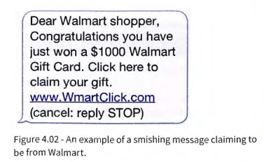
Smishing

Slide 12
Vishing
Vishing is short for voice phishing. It is the act of using a telephone call to try and scam a user into giving their personal data. The scammer will usually pretend that they are a legitimate business calling the person.
The person who is vishing will either say they are alerting the victim to an issue with their account, or advertizing the victim of a profitable gain. They will often ask the victim subtle questions to get the personal data they want. One tactic vishers will som etimes resort to, is that when the victim become a little suspicious and want s to call their bank to check if the call is legitimate, the scammer will not hang up when the victim tries to call their bank.
The victim will the n pick up the telephone to call their bank, but the line is act ually still being held by the scammer. The victim thinks they have called their bank, but it is still th e scammer, and the victim gives t hem their personal details , thinking they are giving them to t heir bank.Unfort unately, it is often the elderly and the vulnerable that are targeted for vishing.

Slide 13
Vishing
There are measures t hat can be ta ken to protect against
vishing:
People should exercise caution when any institution contacts them, especially when they ask for personal
details. If in doubt hang up and call them back on a number that
is known.
People should never give out any personal details regarding a security issue w ith their account. A bank will prevent any kind of attack on an account without need ing assistance from the account holder.

Slide 14
Malware
Malware is a computer program that is designed to damage or disrupt a computer system and the files that are stored on it. Malware can take many forms and we are going to look at a number of them.
Trojan horse
A Trojan horse is a malicious computer program that disguises it self as another application. such as a game or a utility program. When the application is run, the Trojan horse will act as a computer virus would. deleting and
corrupting files in the compute, system.

Slide 15
Worms
A computer worm is a small computer program that uses computer networks and finds security holes to replicate itself. They can exploit a security hole in a piece of softw are or operating system. While replicating they will often clog up network bandwidth and can make things run slowly.
Spyware
Spyware covers quit e a broad range of malware. The term refers to any technology that is used to gather data about a person without their knowledge. It is mos t commonly used to track the movements of people online. A common
type of spyware is a keylogger. This is a piece of software that records the key presses from a keyboard and will allow the person who installed it to gather personal data about the victim.

Slide 16
Adware
Adware is short for advertising-supported software . In its most basic form , it is simply a software program that is used to display adverts that are targeted at the user. It can analyse the websites the user visits and will target them with advertising of a similar nature. Many program developers will justify the inclusion of adware in their product by claiming that it will generate revenue for them keeping the cost of the product lower.
Rootkit
A rootk it is a computer program that enab les a person to gain adm inistrator access to a vic ti m's computer. It normal ly gets install ed because a victim's password is cracked. The person instal ling it can then use the access to stop the compute r recognising that the rootkit is there, so the victim will not know that someone else has complete access to their computer system. Other malware can then be concealed on the computer to cause harm .

Slide 17
Malicious bots
A bot is an app licat ion that is automated and used to carry out simple and repetitive tasks . These are normally tasks that a hum an wo uld find mundan e and time -consuming. Bots can be used for very productive reasons, but they
can also be used as a form of malware . Malicious bots are used by cyber criminals in a variety of ways:-
SPAM bots are used to bombard peopl e's email in box with SPAM emails.
Zombie bots are used to create a bot network. The bot will lay dormant on a computer until an attack is launched. The computer will then be connected with lots of other computers that have been compromised by zombie bots to launch a large-scale attack on an organisation.
• Chatter bot s will pretend to be humans on sites such as social networking
and dating sites.

Slide 18
Ransomware
Ransomware is a type of malwar e that restricts a user's access to their comput er system and files. The ransom ware will norm ally demand that the user pays
a ransom in order to regain access to their computer system.Some ransomware programs will completely lock a user's system and some will encrypt all of the files on their system in a way that renders them useless. Ransomware will normally try to enter a system in a similar way to a Trojan horse.
The message or ransom with wh ich the user is presented will often imitate a law enforcement agency. It will falsely claim that the system has been used for illegal activity and that a ransom must be paid to regain access to the system.

Slide 19
How can malware be avoided?
Remember
Malware can be ver·y difficult to remove from a computer system. It can often take num erous scans from anti-v irus software, as well as the use of various malware removal programs, depending on the type of malw are infecting the system
A user should never open a program unless they know it is legitimate.
A user should have a firewall in place that is monitoring their internet traffic.
A user should regularly run an anti -virus check and malware detection
software on the ir computer system, to detect the presence of any malware.
Any anti-virus or malwa re detec tion program should be kept up to dat e in
order to detect newly developed malware.
A user shou ld not open any attachments to ema ils from unkn own users.
A user should use op en Wi-Fi po ints wit h extreme caution as anybody could be connecte d to them.

Slide 20
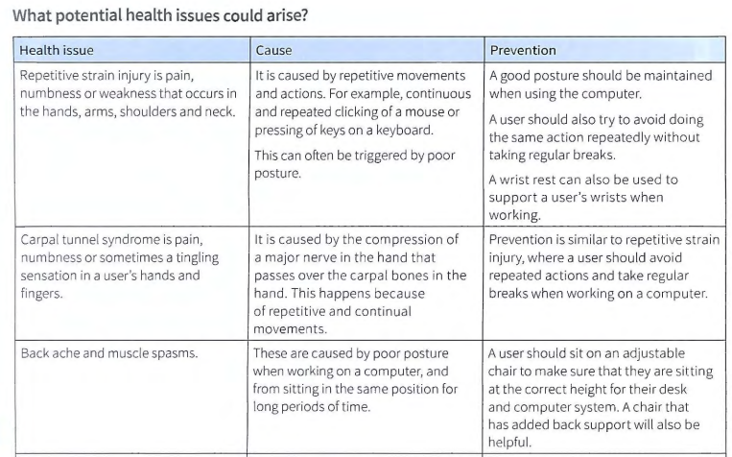
Health and Safety

Slide 21
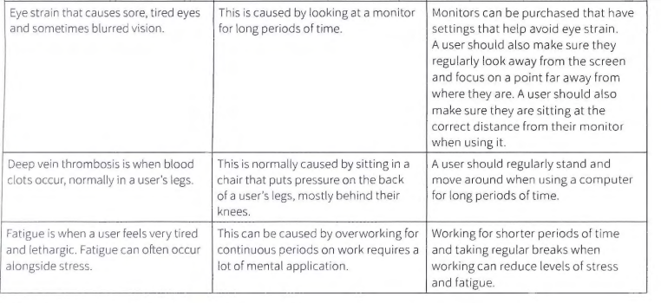
Health and Safety

Slide 22
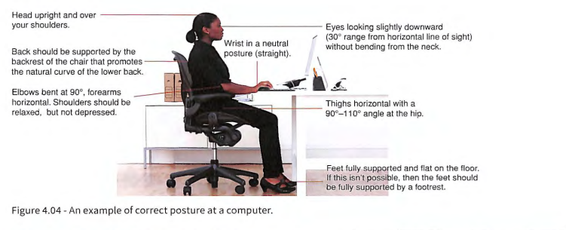
Health and Safety

Slide 23
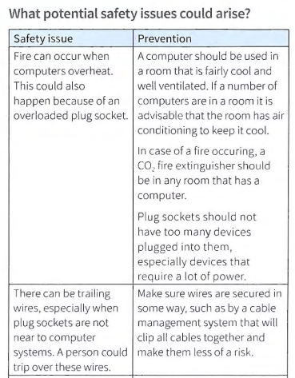
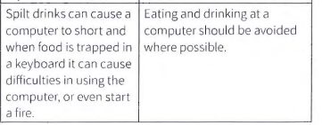
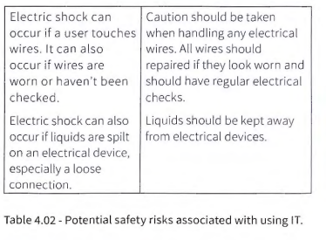
Health and Safety

